Slide 1
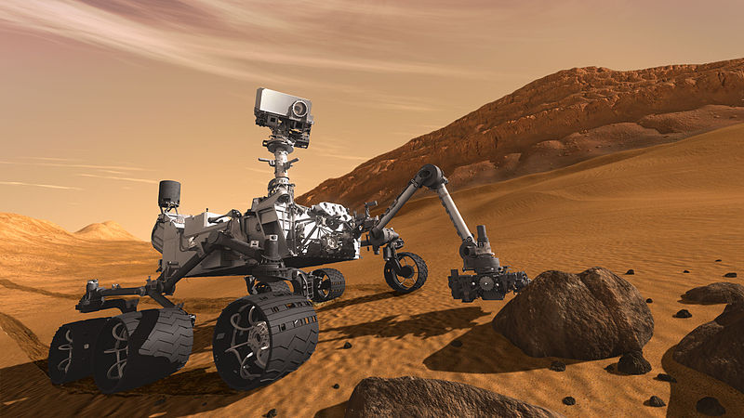

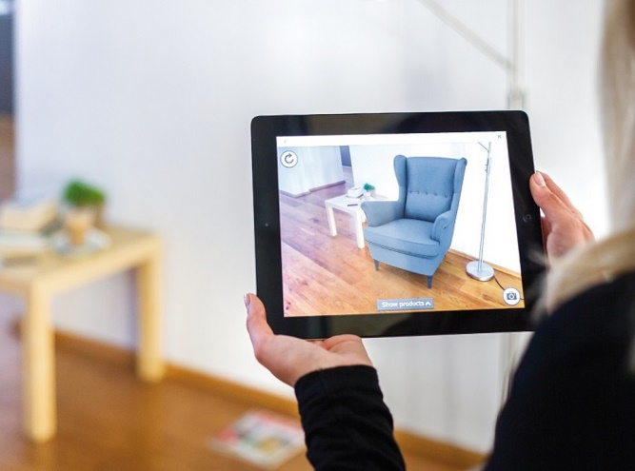
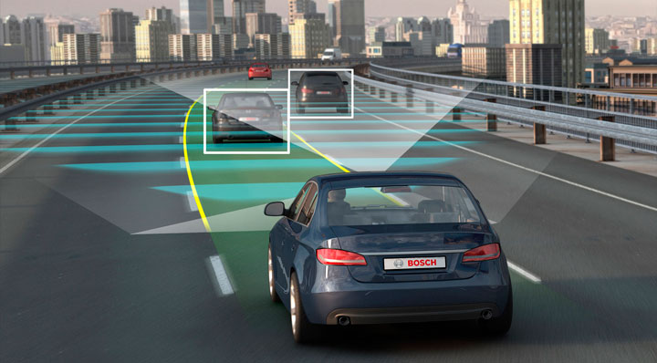
Intro to Computer Vision

Slide 2
Adding a new slide to test github

Slide 3
Readings
Szeliski, Chapter 1 (Introduction)

Slide 4
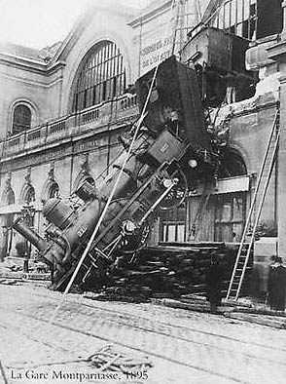
Every image tells a story
Goal of computer vision: perceive the “story” behind the picture
Compute properties of the world
3D shape
Names of people or objects
What happened?

Slide 5
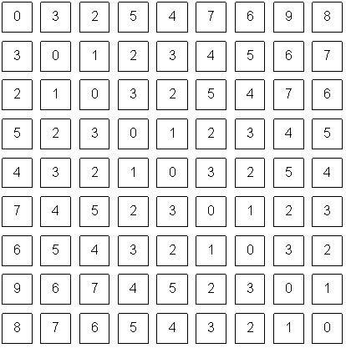
The goal of computer vision
What an image looks like to a computer

Slide 6
Can computers match human perception?
Yes and no (mainly no)
computers can be better at “easy” things
humans are better at “hard” things
But huge progress
Accelerating in the last five years due to deep learning
What is considered “hard” keeps changing

Slide 7
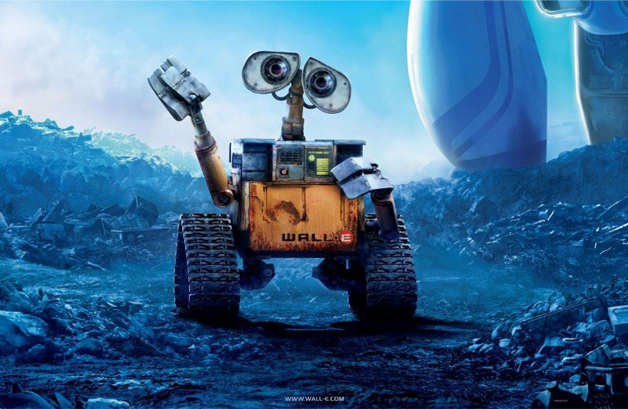
The goal of computer vision

Slide 8
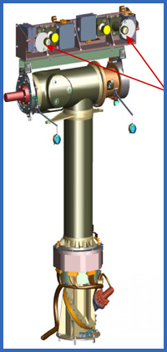
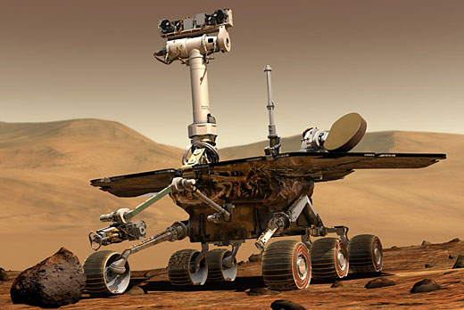
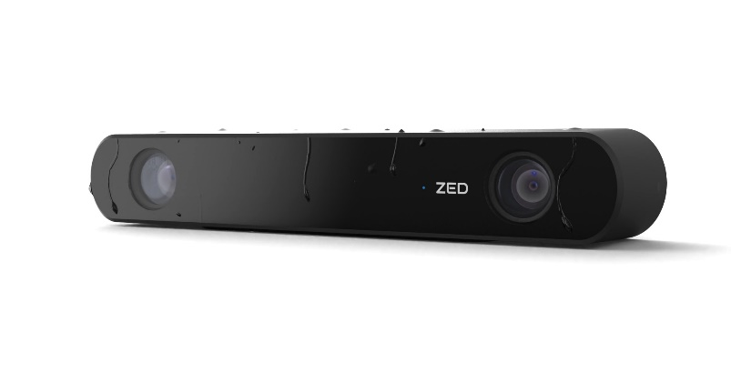
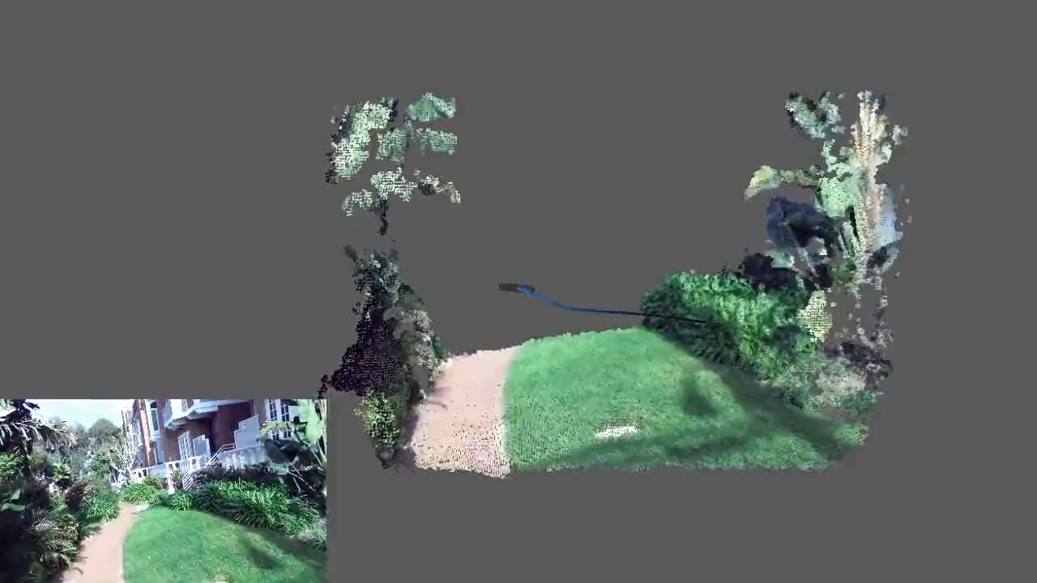
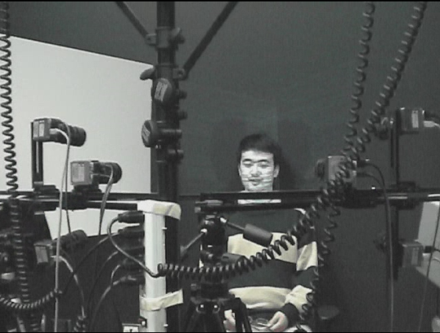
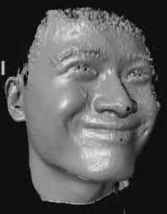
The goal of computer vision
Compute the 3D shape of the world
ZED 2i Camera

Slide 9
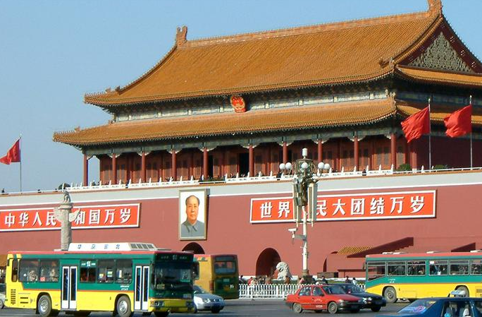
sky
building
flag
face
banner
wall
street lamp
bus
bus
cars
slide credit: Fei-Fei, Fergus & Torralba

Slide 10
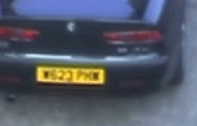
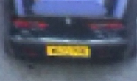
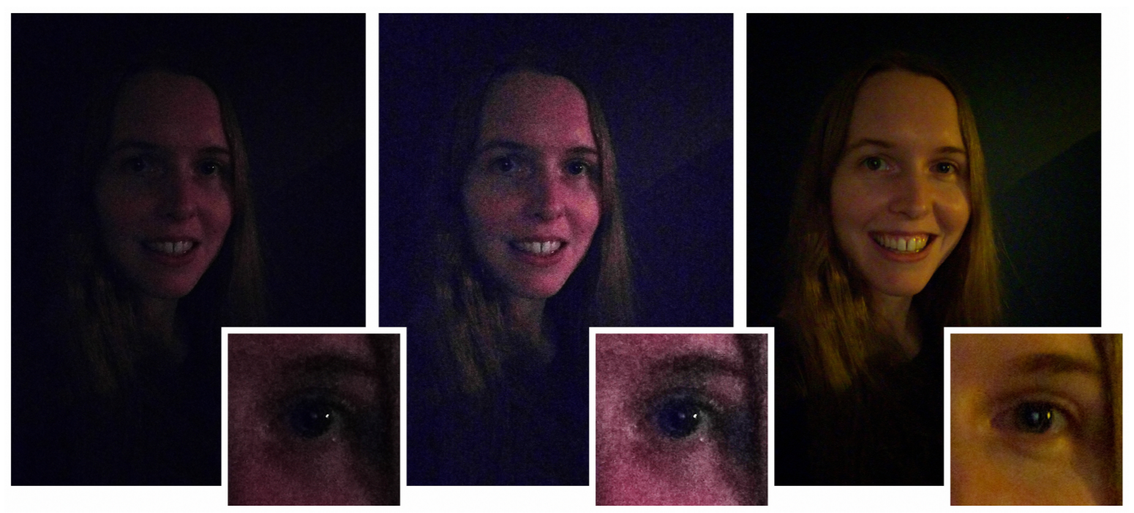
The goal of computer vision
Improve photos (“Computational Photography”)
Super-resolution (source: 2d3)
Removing objects (Google Magic Eraser)
Low-light photography
(credit: Hasinoff et al., SIGGRAPH ASIA 2016)

Slide 11
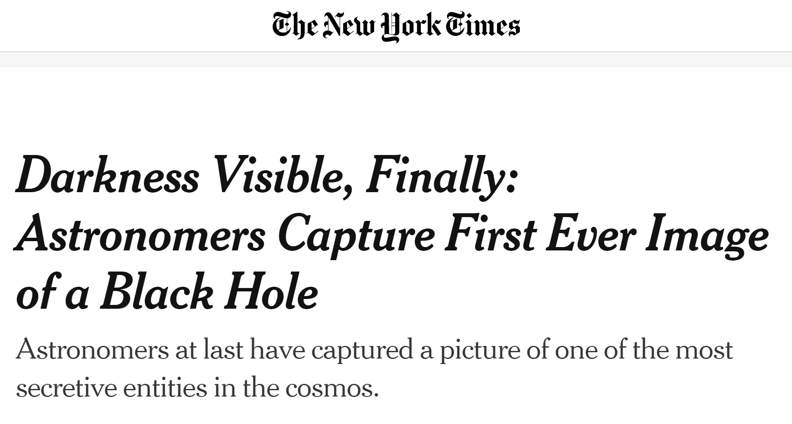
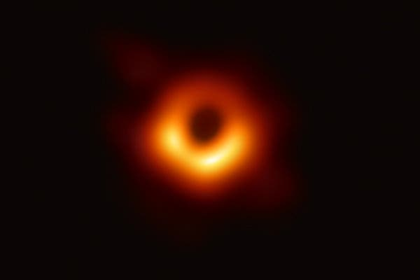
April 10, 2019

Slide 12

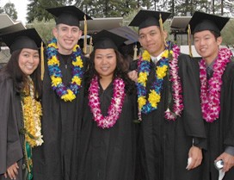
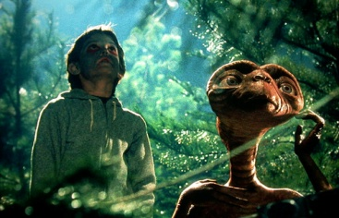

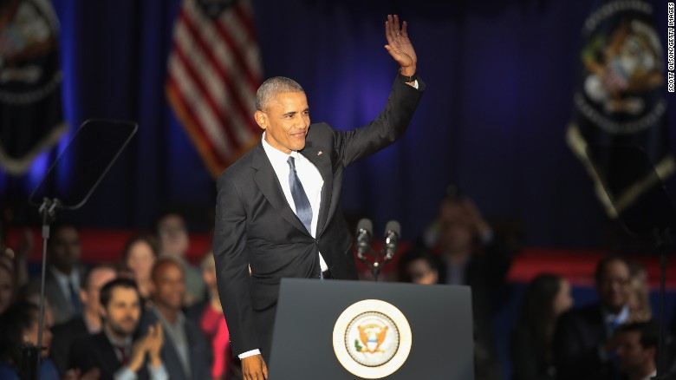
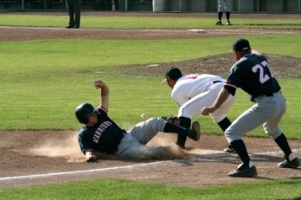
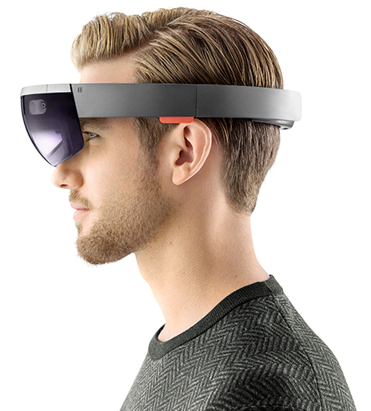






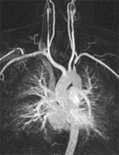
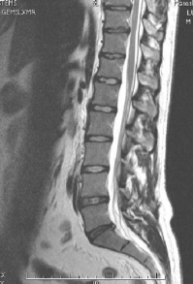
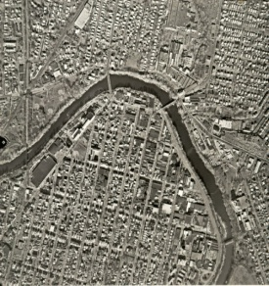
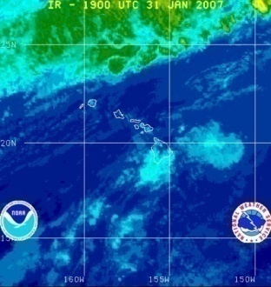

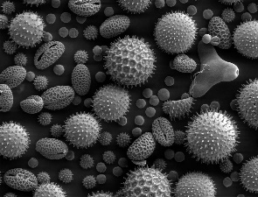
Why study computer vision?
Billions of images/videos captured per day
Huge number of potential applications
The next slides show the current state of the art

Slide 13

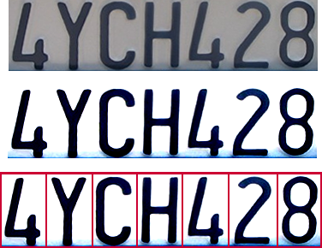
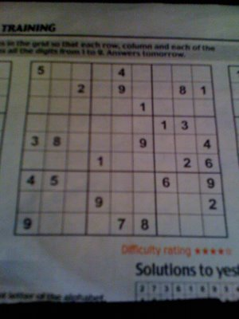
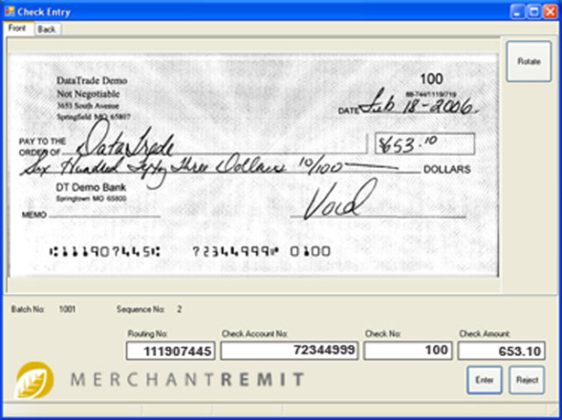
Optical character recognition (OCR)
If you have a scanner, it probably came with OCR software
Digit recognition, AT&T labs (1990’s)
http://yann.lecun.com/exdb/lenet/
License plate readers
http://en.wikipedia.org/wiki/Automatic_number_plate_recognition
Sudoku grabber
http://sudokugrab.blogspot.com/
Automatic check processing

Slide 14
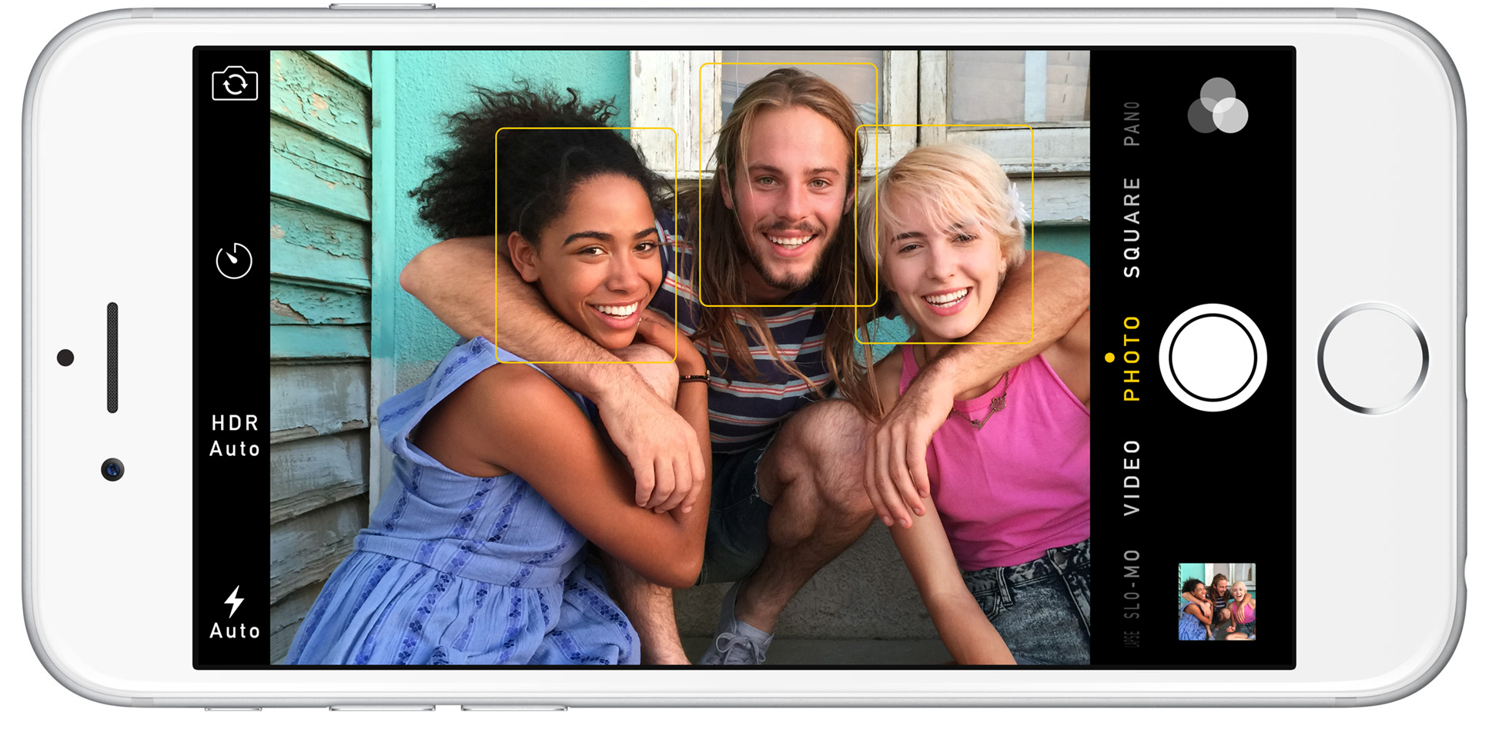
Face detection
Nearly all cameras detect faces in real time
(Why?)
Notes:
Why would this be useful? Main reason is focus. Also enables “smart” cropping.

Slide 15
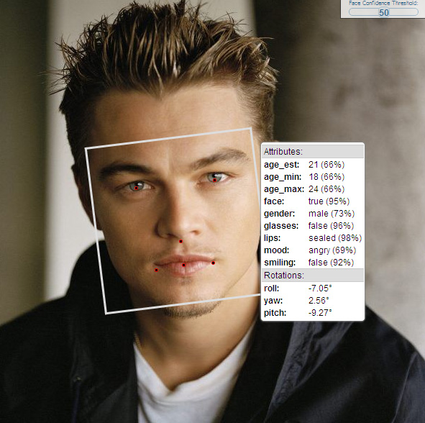
Face analysis and recognition

Slide 16
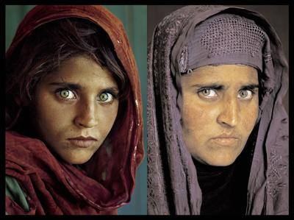
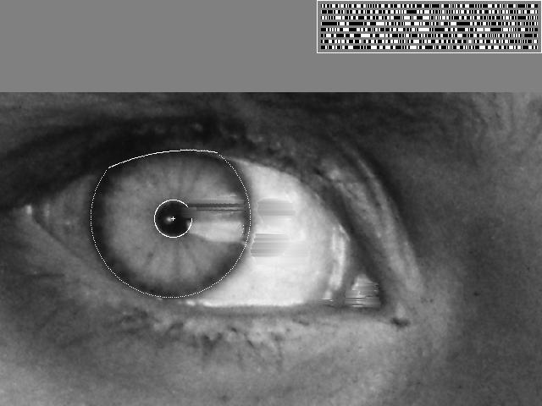
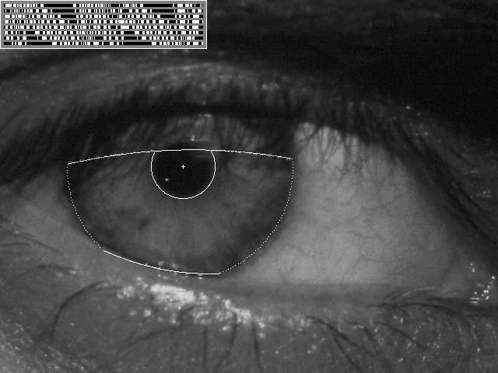
Vision-based biometrics
“How the Afghan Girl was Identified by Her Iris Patterns” Read the story
Source: S. Seitz

Slide 17
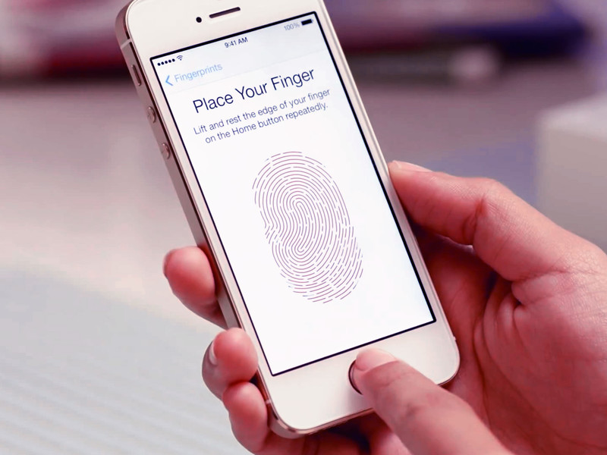
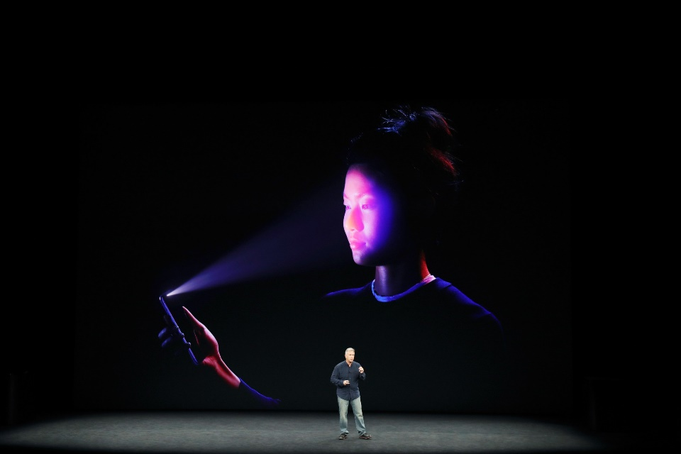
Login without a password
Fingerprint scanners on many new smartphones and other devices
Face unlock on Apple iPhone X See also http://www.sensiblevision.com/

Slide 18
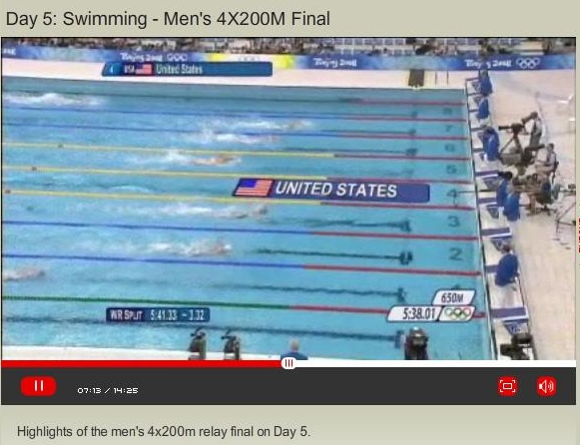
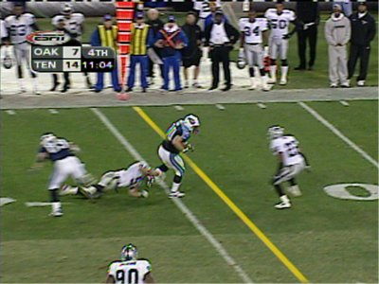
Sports
Sportvision first down line
Explanation on www.howstuffworks.com
Source: S. Seitz

Slide 19
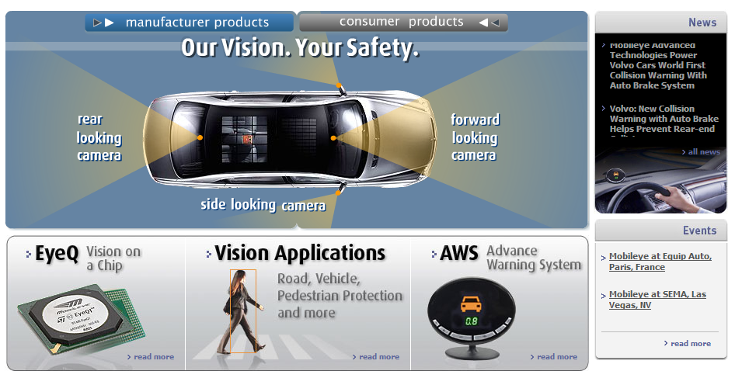
Smart cars
Tesla Autopilot
Safety features in many cars

Slide 20
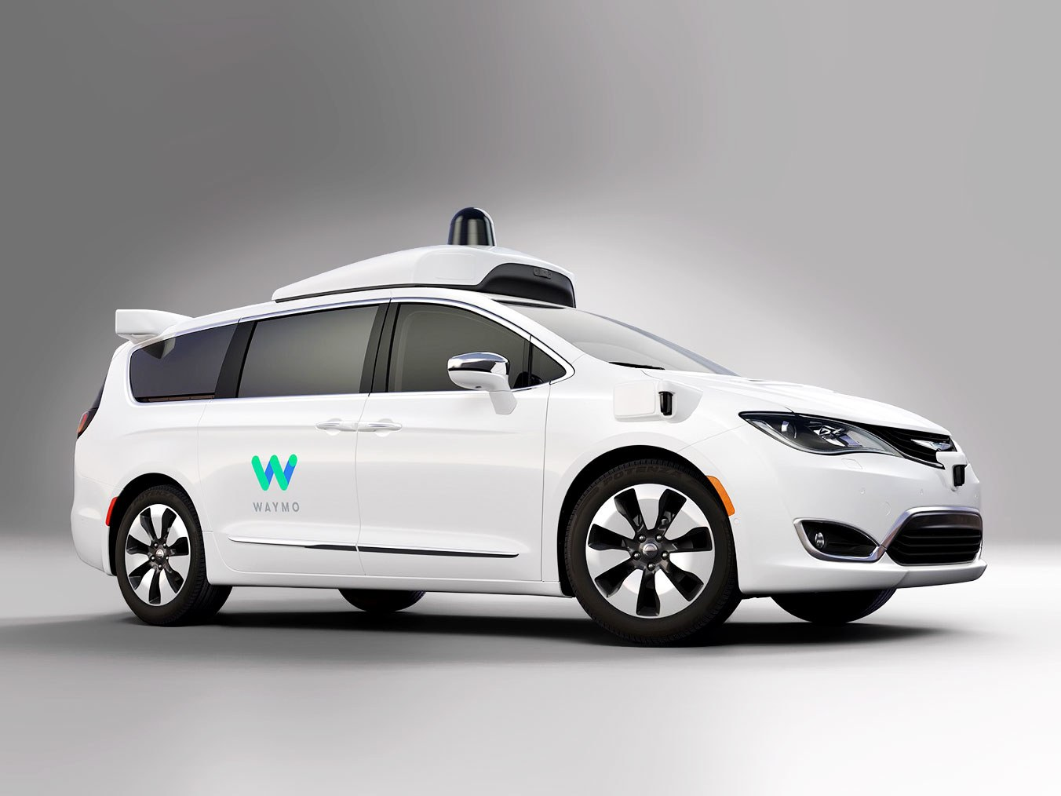
Self-driving cars
Waymo

Slide 21
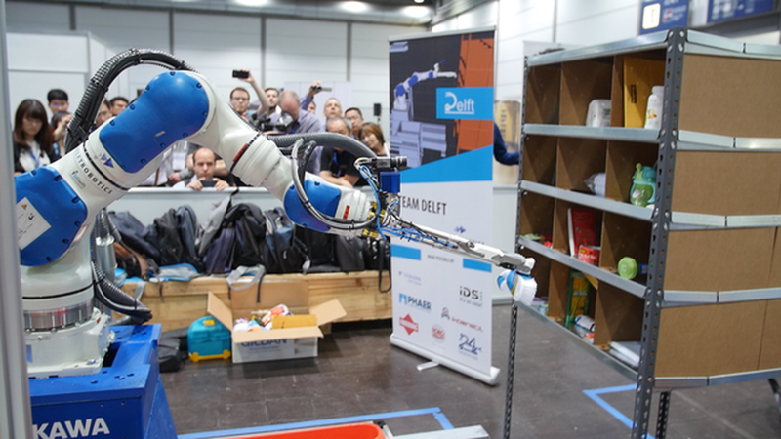
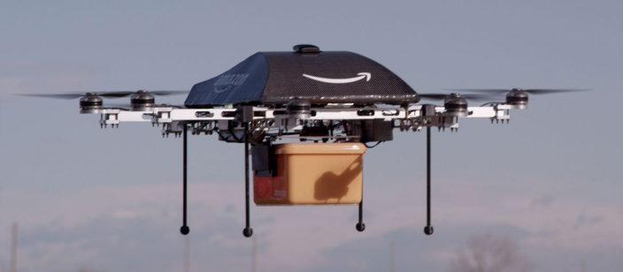
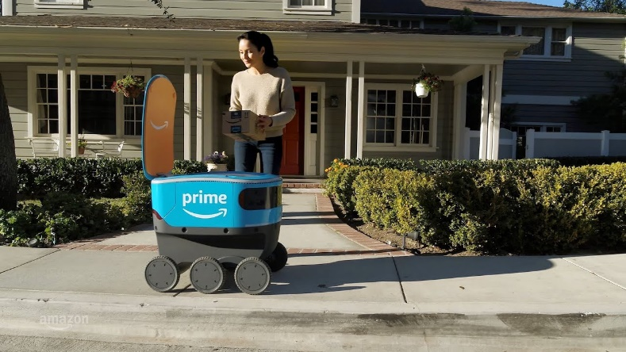
Robotics
NASA’s Mars Curiosity Rover
https://en.wikipedia.org/wiki/Curiosity_(rover)
Amazon Picking Challenge
http://www.robocup2016.org/en/events/amazon-picking-challenge/
Amazon Prime Air
Amazon Scout

Slide 22
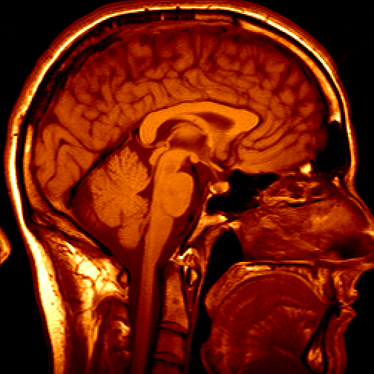
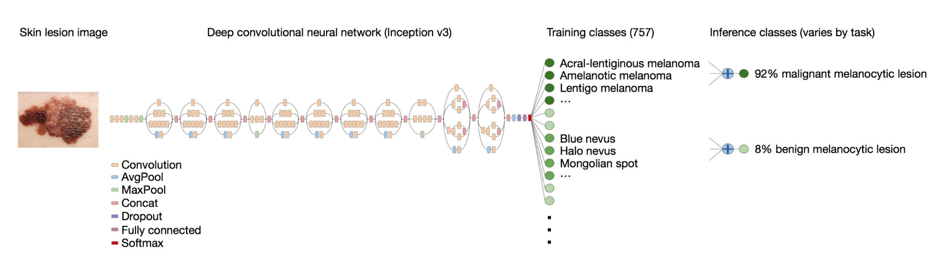
Medical imaging
3D imaging (MRI, CT)
Skin cancer classification with deep learning https://cs.stanford.edu/people/esteva/nature/

Slide 23
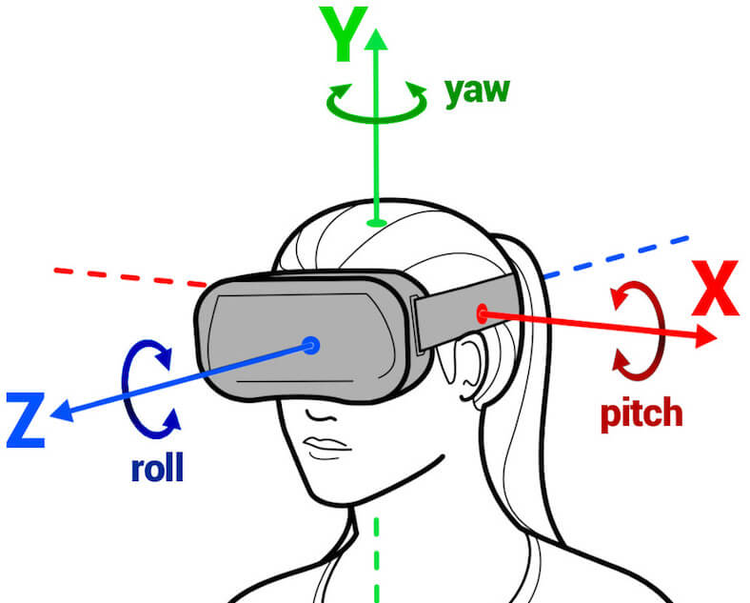
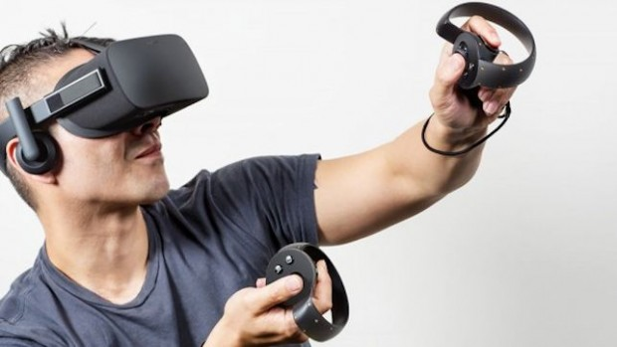
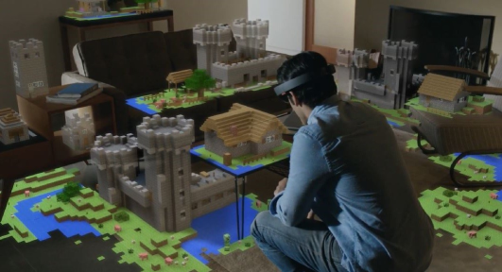

Virtual & Augmented Reality
6DoF head tracking
Hand & body tracking
3D scene understanding
3D-360 video capture

Slide 24
Current state of the art
You just saw many examples of current systems.
Many of these are less than 5 years old
Computer vision is an active research area, and rapidly changing
Many new apps in the next 5 years
Deep learning and generative methods powering many modern applications
Many startups across a dizzying array of areas
Generative AI, robotics, autonomous vehicles, medical imaging, construction, inspection, VR/AR, …

Slide 25







Why is computer vision difficult?
Viewpoint variation
Credit: Flickr user michaelpaul
Scale
Illumination

Slide 26






Why is computer vision difficult?
Motion (Source: S. Lazebnik)
Intra-class variation
Background clutter
Occlusion

